Slide 1


Abhishek Kumar
May 30, 2024

Slide 2

Outline
Executive Summary
Introduction
Methodology
Results
Conclusion
Appendix

Slide 3
Executive Summary
Summary of methodologies
The following report deals with SpaceX’s Falcon 9 rocket launches. It aims to understand the factors contributing to a successful SpaceX launch. The dataset is first collected through a CSV file. Web scraping methods such as Beautiful Soup were also used to obtain the data. After obtaining the right data and cleaning it using Pandas, Exploratory Data Analysis was performed to gather further insights into the data. Data Visualization tools such as Folium, Matplotlib, Seaborn, and Plotly Dash were used to display data in a human-readable format. In conclusion for the research, Machine Learning prediction models offered by Scikit-Learn were used to build models that best-predicted success rate for Launches
Summary of all results

Slide 4
Introduction
Project background and context:
The Falcon9 is one of SpaceX’s most popular rockets.
SpaceX advertises Falcon9’s cost to be around 62 Million USD, whereas other providers quote 165 Million dollars for their market equivalents.
Much of these savings are because Falcon9 is able to reuse the first stage of its launch.
Problems you want to find answers
If we can determine if the first stage will land, we can determine the cost of the launch.
Therefore, this study aims to study the causing factors behind a successful Falcon9 launch for SpaceX.

Slide 5

Section 1

Slide 6
Methodology
Executive Summary
Data collection methodology:
Data was collected using 3 different methods: 1)SpaceX API, 2)Web scraping
Perform data wrangling
Data was processed using 2 different methods: 1)The Pandas Library, 2) SQL
Perform exploratory data analysis (EDA) using visualization and SQL
Perform interactive visual analytics using Folium and Plotly Dash
Perform predictive analysis using classification models
Scikit-Learn Library: LogisticRegression, Support Vector Machines, Decision Tree Classifiers etc.

Slide 7
Data Collection
Data was collected using 2 different methods/sources:
SpaceX API
Web Scraping

Slide 8
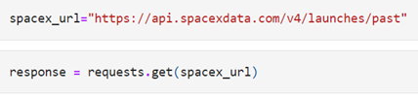
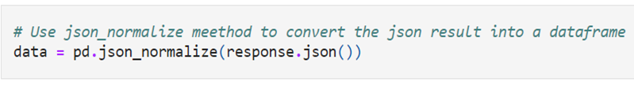
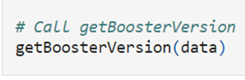
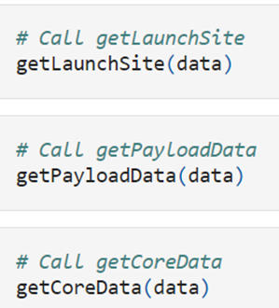
Data Collection – SpaceX API
The requests library was used to obtain data from the SpaceX API, followed by json normalization using the Pandas library.
Furthermore, new columns were created using user-defined functions, as can be seen in the notebook below.
https://github.com/Abhi-61/SpaceX_Rocket_Launch_Data_Analysis/blob/main/jupyter-labs-spacex-data-collection-api.ipynb

Slide 9
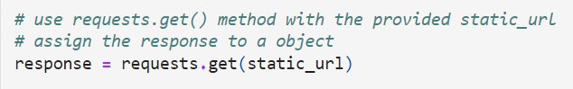
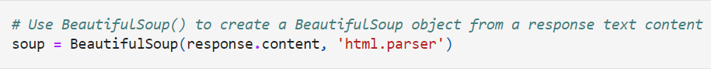
Data Collection - Scraping
The response library was used again to access the Wikipedia page of SpaceX, which was then converted into a BeautifulSoup object, and then finally transformed into a pandas Dataframe.
https://github.com/Abhi-61/SpaceX_Rocket_Launch_Data_Analysis/blob/main/jupyter-labs-webscraping.ipynb

Slide 10
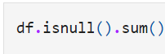
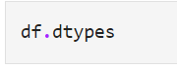
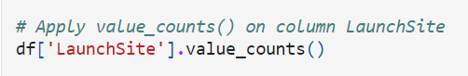
Data Wrangling
Once the data was converted into a Pandas dataframe, it had to be further analyzed for cleaning.
You need to present your data wrangling process using key phrases and flowcharts
First and foremost, the datatypes of each attribute in the dataframe had to be determined in order to understand what methods can be applied to the dataset.
Moreover, null_counts and the value_counts of the important attributes had to be determined before moving forward.
https://github.com/Abhi-61/SpaceX_Rocket_Launch_Data_Analysis/blob/main/labs-jupyter-spacex-Data%20wrangling.ipynb

Slide 11
EDA with Data Visualization
What data had to be visualized and why?
Cat plot of PayloadMass vs FlightNumber, to see if there was any change in Payload Mass as FlightNumber increased. (Note that Flight Number was sequential ranging from 1 to 90).
Scatterplot of FlightNumber vs LaunchSites to determine in which sites were a majority of the rockets were launched.
Scatterplot of LaunchSite and PayloadMass to determine if certain LaunchSites were used to launch rockets only of a specific Payload Mass.
Bar Chart of success rate with regards to the orbit in which the rocket was launched.
Scatterplot representing the number of Flights in each orbit, and colored based on whether the flight was a success or failure.
Add the GitHub URL of your completed EDA with data visualization notebook, as an external reference and peer-review purpose

Slide 12
EDA with Data Visualization (Contd.)
What data had to be visualized and why?
6) Scatterplot of Orbit vs Payload Mass of each Flight to gather insight on whether certain orbit rockets had a specific payload mass.
7) Line plot of the average success rate of launches in each year to study the general trend of SpaceX’s Falcon9 Launches.
https://github.com/Abhi-61/SpaceX_Rocket_Launch_Data_Analysis/blob/main/edadataviz.ipynb

Slide 13
EDA with SQL
Using bullet point format, summarize the SQL queries you performed
Select the distinct Launch sites in the dataset to determine the unique launch sites used for Falcon9 Launches
Select the first 5 records whose Launch Sites began with characters “CCA”
Select the total payload mass carried by boosters launched by NASA.
Display the average payload mass carried by booster version F9 v1.1
List the Date when the first successful ground pad rocket was launched
List boosters of payload mass between 4000 and 6000kg which have success in drone ship
Display boosters that have carried the maximum payload mass

Slide 14
EDA with SQL (Contd.)
List Records of launches that failed by drone ship in 2015.
List landing outcomes between 2010-06-04 and 2017-03-20, ranked in descending order
https://github.com/Abhi-61/SpaceX_Rocket_Launch_Data_Analysis/blob/main/jupyter-labs-eda-sql-coursera_sqllite.ipynb

Slide 15
Build an Interactive Map with Folium
Objects Added to Folium Map:
Marker and Circle representing the NASA Johnson Space Center at Houston, Texas. This was used as the center of the Map.
A circle and marker for each distinct launch site in the dataset, to identify the sites better.
Marker Cluster for each launch site where each marker represented either a successful launch(in green) or failed launch(in red). This made it easier to identify launch sites with higher successful launches.
A marker and polyline connecting the launchsite to the marker representing the nearest coastline, highway, city etc. to the launch site VAFB SLC-4E.
https://github.com/Abhi-61/SpaceX_Rocket_Launch_Data_Analysis/blob/main/lab_jupyter_launch_site_location.ipynb

Slide 16
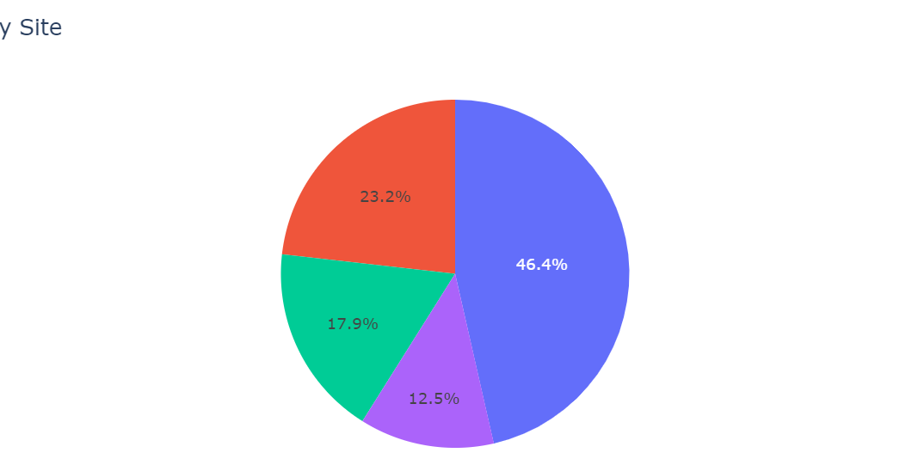
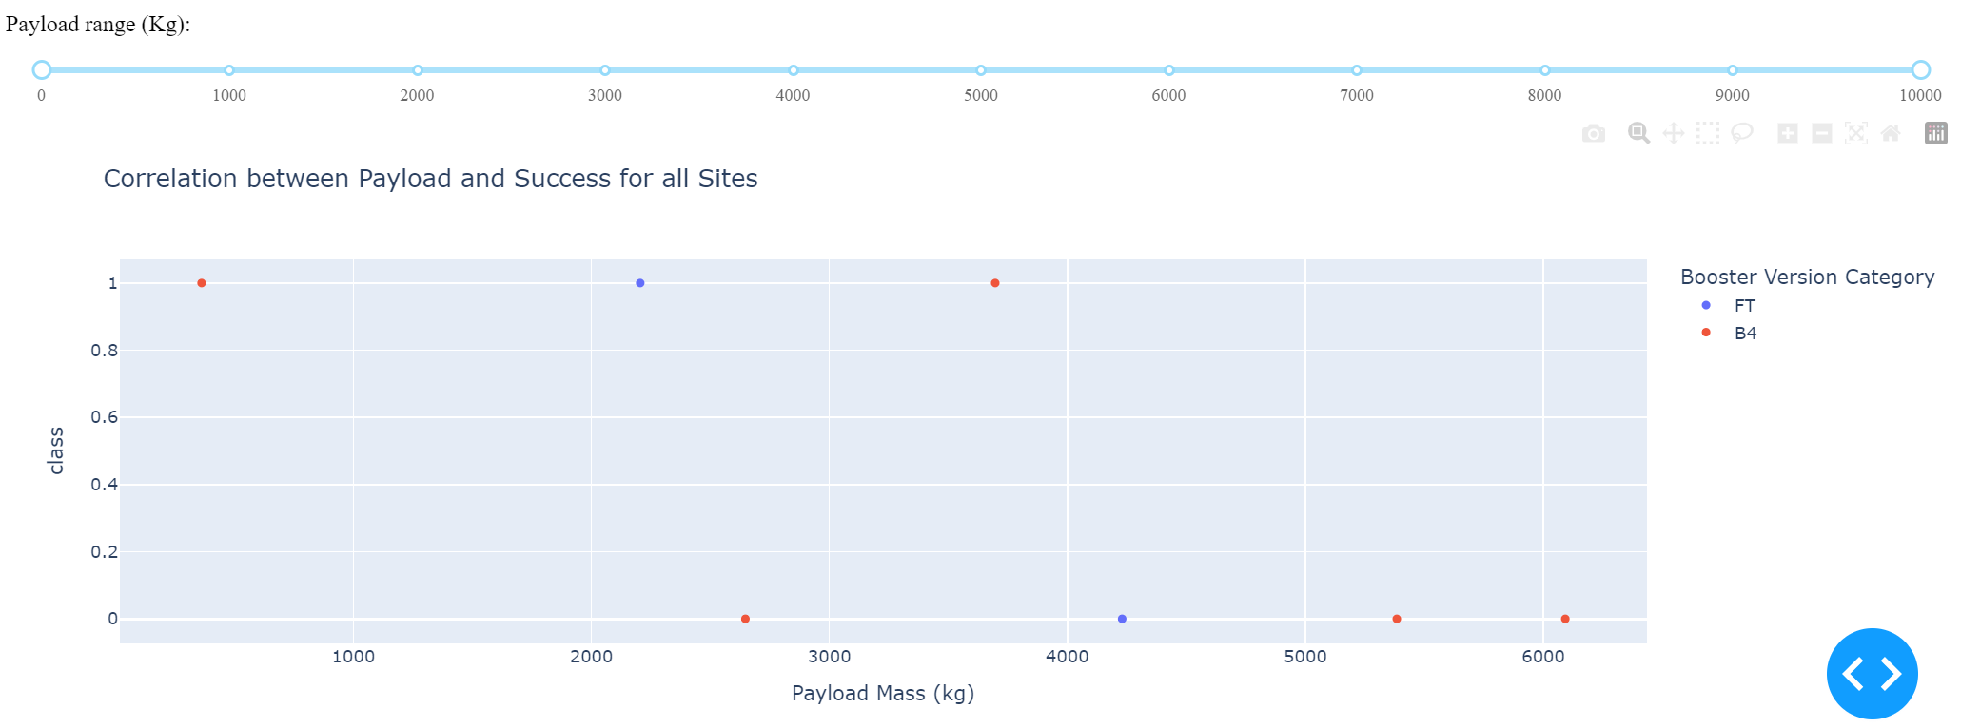
Build a Dashboard with Plotly Dash
Interactions and Plots that were added to the Dash Application:
Success Rate of All Sites compared with each other. (Dropdown Menu)
Success Rate of each Launch site Taken one at a time. (Dropdown Menu)
Scatterplot of Success Rate of the selected launch site with regards to flights of different payload mass. A slider was used to filter the minimum and maximum payload range
https://github.com/Abhi-61/SpaceX_Rocket_Launch_Data_Analysis/blob/main/plotly-dash-application/spacex_dash_app.py

Slide 17
Predictive Analysis (Classification)
Steps used in determining the best predictive model:
Standardize data using StandardScaler(), and then fit and transform the data.
Split the data into train and test data using train_test_split.
Use Grid Search on 4 different predictors, namely Logistic Regression, Support Vector Machines, Decision Tree Classifiers, K Nearest Neighbors.
Determine which predictor is best based on F1_Score
https://github.com/Abhi-61/SpaceX_Rocket_Launch_Data_Analysis/blob/main/SpaceX_Machine%20Learning%20Prediction_Part_5.ipynb

Slide 18
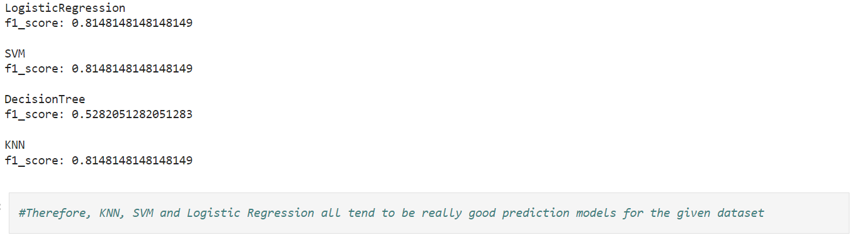
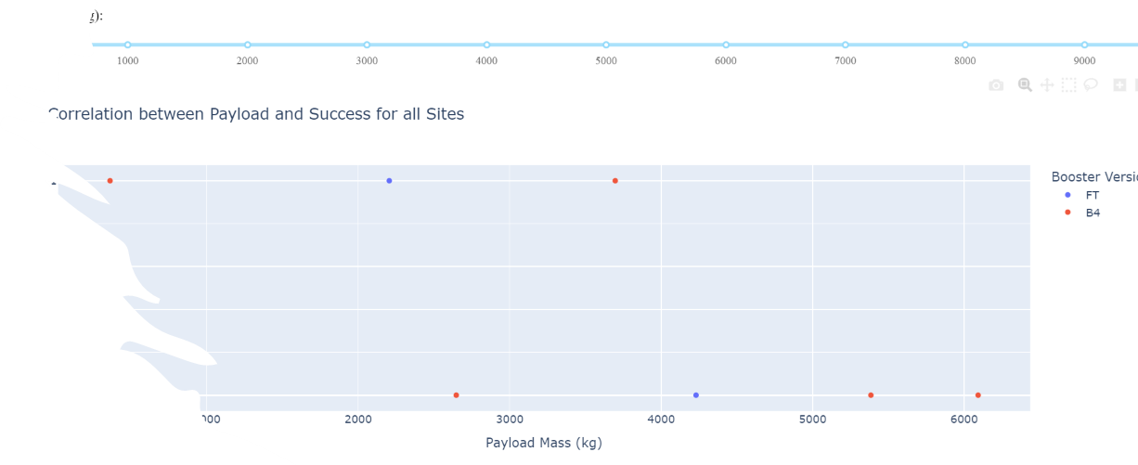
Results
Exploratory data analysis results
Most Flights were launched at CCAFS SLC-40
Most Flights launched had a payload mass below 8000kg, especially for CCAFS SLC-40
Flights launched into orbits LEO, ISS, GTO and SO have significantly higher success rates.
Success rates kept increasing since 2013 until 2020.
Interactive analytics demo in screenshots
Predictive analysis results

Slide 19

Section 2

Slide 20
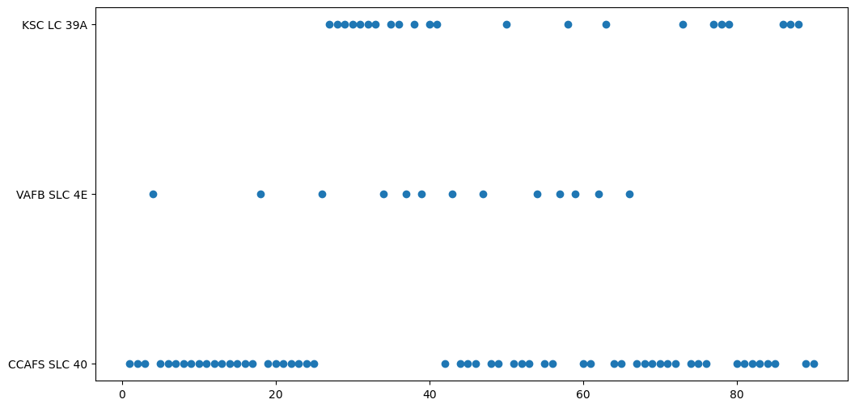
Flight Number vs. Launch Site
A majority of Falcon9 Launches were from the CCAFS SLC-40 Launch Site.

Slide 21
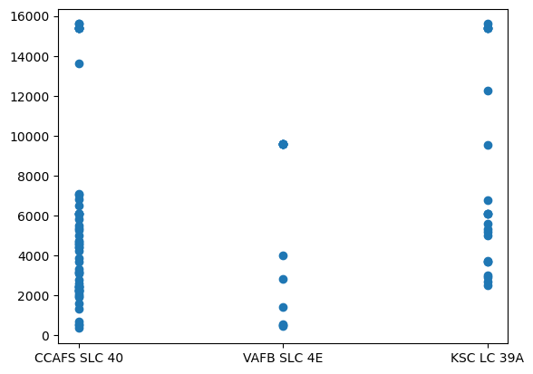
Payload vs. Launch Site
Most of the flights launched from all launch sites seem to have a payload mass of below 8000kg

Slide 22
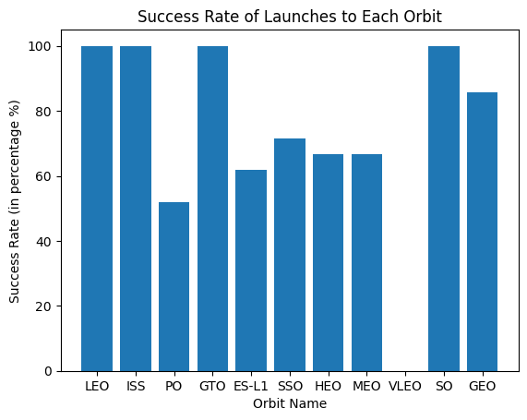
Success Rate vs. Orbit Type
Flights launched into orbits LEO, ISS, GTO and SO have 100% success rates.

Slide 23
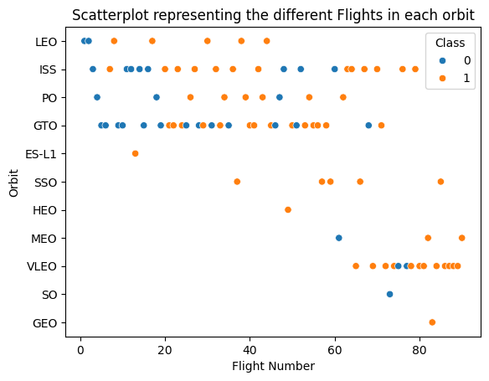
Flight Number vs. Orbit Type
Orbits SSO, HEO, MEO, VLEO, SO, GEO had Falcon9 flights launched into them only in the later launches of SpaceX.

Slide 24
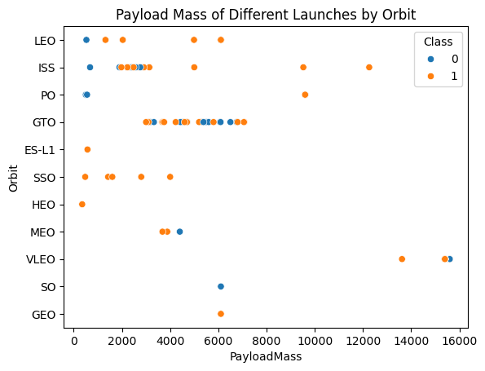
Payload vs. Orbit Type
Most flights were launched into orbits GTO and ISS, with payload mass below 8000kg.

Slide 25
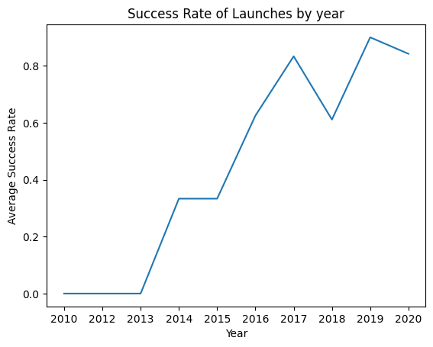
Launch Success Yearly Trend
Success rates for Falcon9 launches showed an upward trend since 2013 until 2020 with a slight dip in 2018.

Slide 26
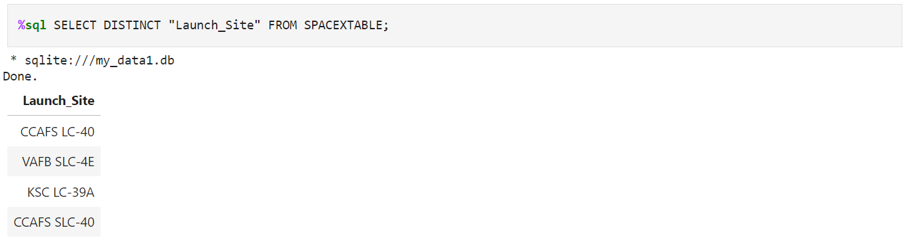
All Launch Site Names
The Unique launch sites of Falcon 9 space launches can be extracted from the dataset as shown in the query below.
Therefore, the 4 unique launch sites in the dataset are CCAFS LC-40, CCAFS SLC-40, VAFB SLC-4E, KSC LC-39A.

Slide 27
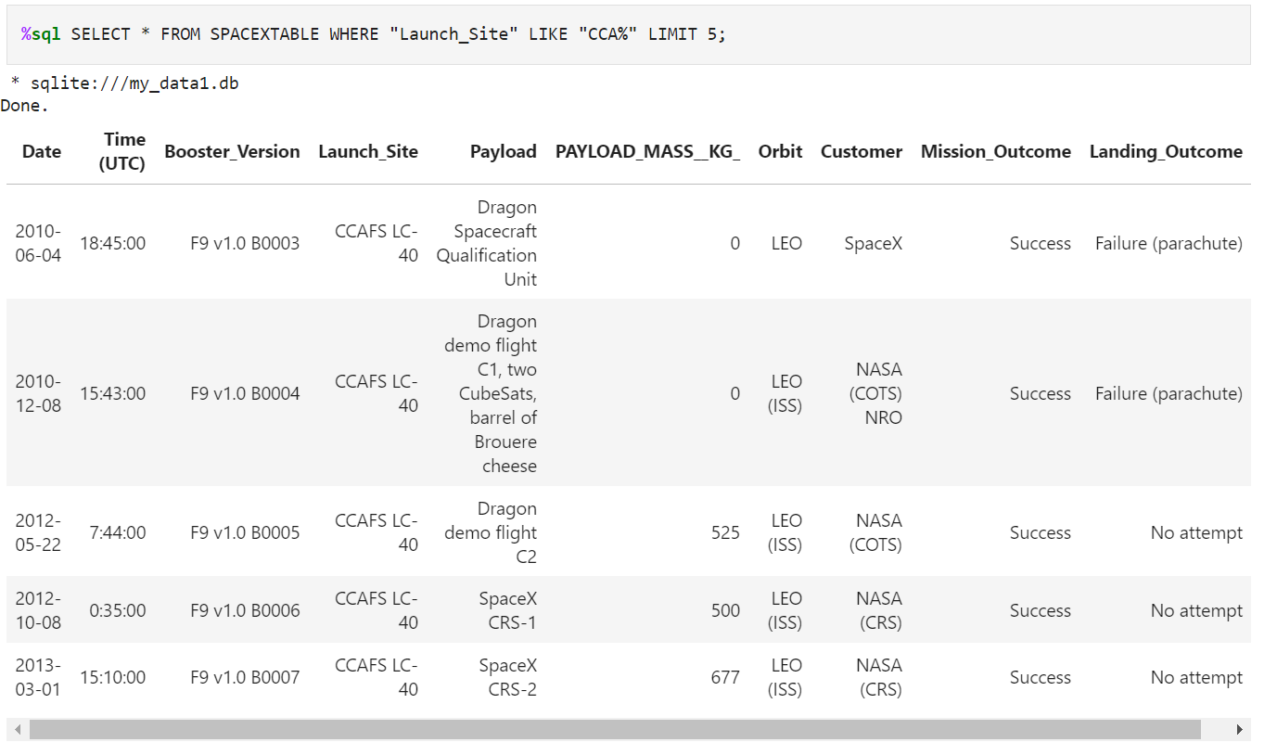
Launch Site Names Begin with 'CCA'
The query to display the first records of launch sites beginning with CCA is as shown below:
It can be seen that all the missions in the retrieved result are successes.

Slide 28
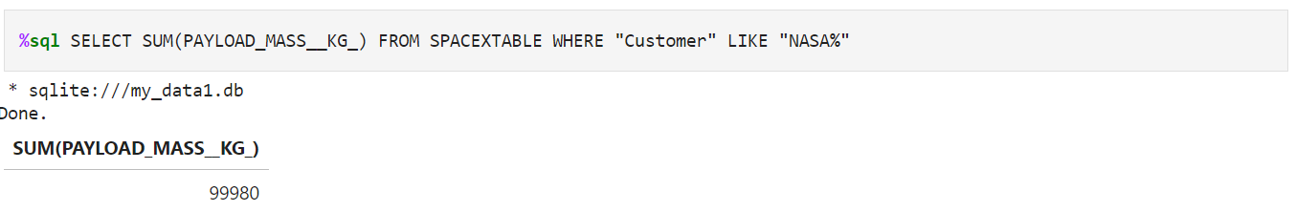
Total Payload Mass
The total payload mass of boosters launched by NASA is retrieved using the query:
As seen above, NASA has sent boosters with a combined payload mass of 99980 Kg

Slide 29
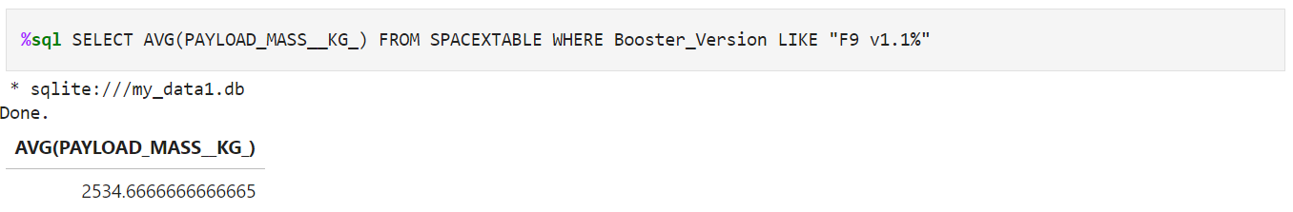
Average Payload Mass by F9 v1.1
The average payload mass carried by booster version F9 v1.1is given by the query:
The average payload mass as shown above carried by booster version F9 v1.1 is 2534.67 Kg

Slide 30
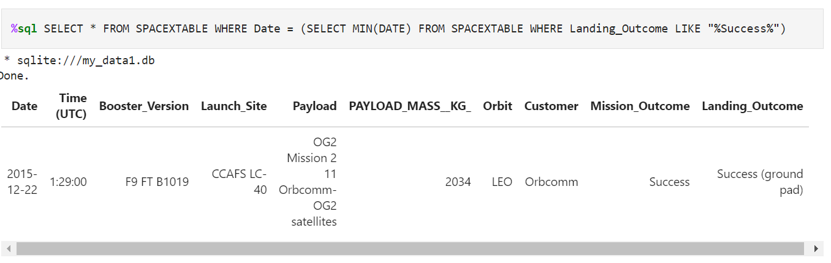
First Successful Ground Landing Date
The first successful ground pad launch is given by the query:
As shown in the result above, the launch was conducted on 22nd December 2015.

Slide 31
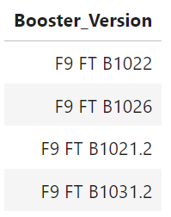
Successful Drone Ship Landing with Payload between 4000 and 6000
The names of boosters which have successfully landed on drone ship and had payload mass greater than 4000 but less than 6000 is given by the query:
SELECT Booster_Version FROM SPACEXTABLE WHERE Landing_Outcome = "Success (drone ship)" AND PAYLOAD_MASS__KG_ BETWEEN 4000 AND 6000
As shown in the result set above, the successful drone ship missions with payload mass between 4000 and 6000 contain the above-given boosters.

Slide 32
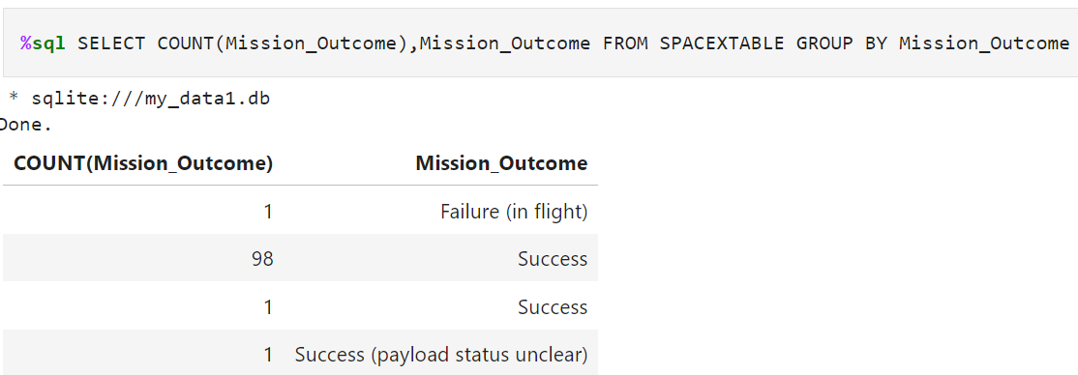
Total Number of Successful and Failure Mission Outcomes
The total number of successful and unsuccessful missions is given by the query:
A total of 100 successful missions and 1 failure.

Slide 33
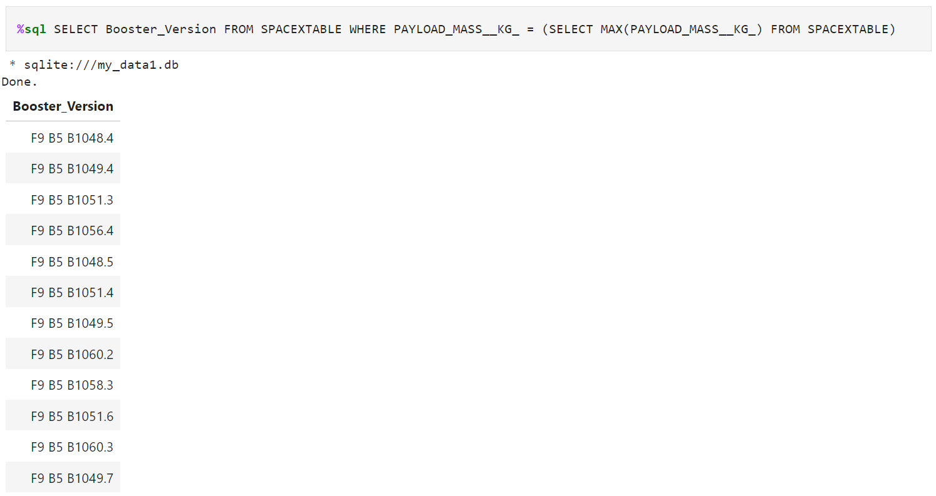
Boosters Carried Maximum Payload
The names of the booster that have carried the maximum payload mass is given by the query:
The boosters that have carried the maximum payload is given above.

Slide 34
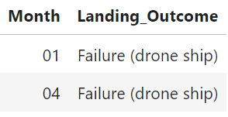
2015 Launch Records
The launch records of all failed landing outcomes in 2015 is given by the query:
SELECT substr(Date, 6,2) as Month, "Landing_Outcome" FROM SPACEXTABLE WHERE "Landing_Outcome" LIKE "%Failure (drone ship)%" AND substr(Date, 0,5) = '2015’
2 Drone ship failures occurred in 2015, in January and April as shown above.

Slide 35
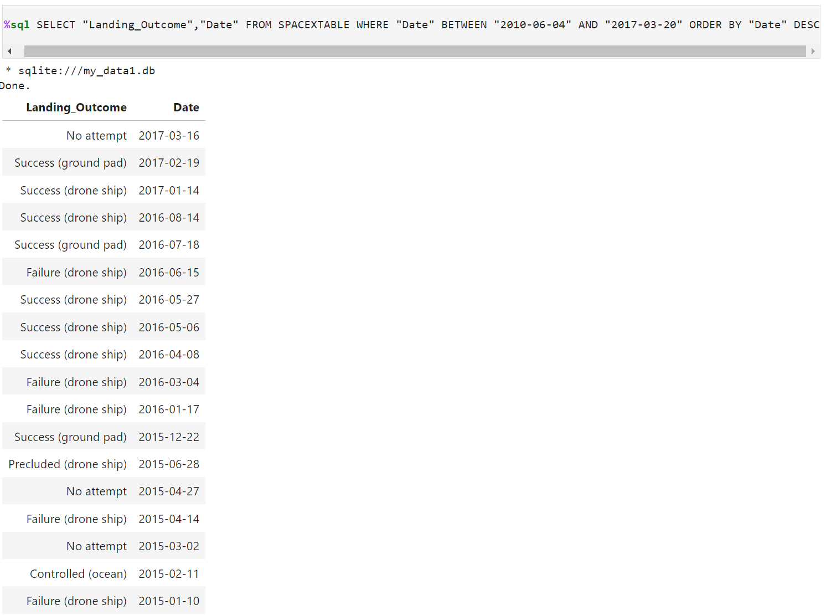
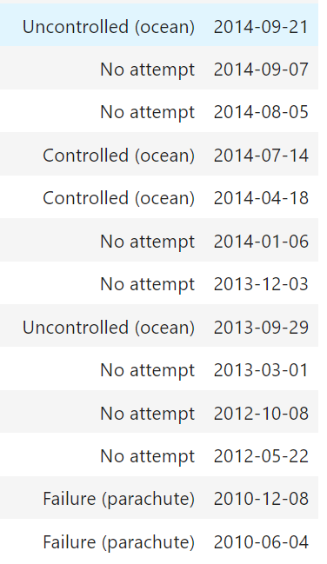
Rank Landing Outcomes Between 2010-06-04 and 2017-03-20
The failed landing_outcomes in drone ship, their booster versions, and launch site names for in year 2015 is given by the query:

Slide 36

Section 3

Slide 37
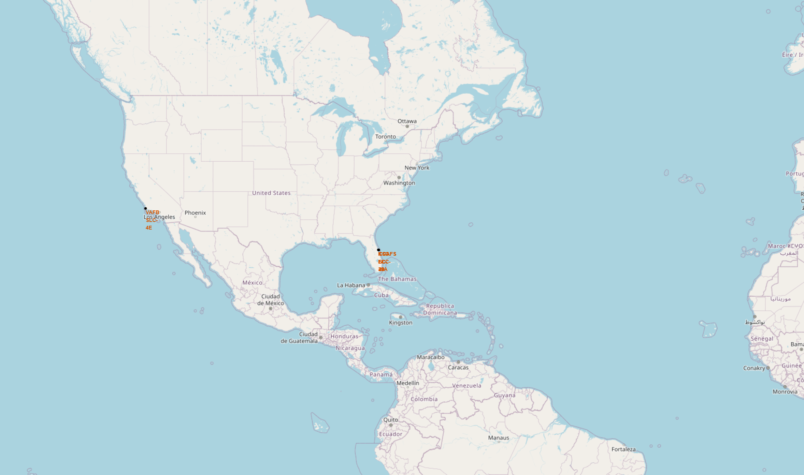
There is one launch site on the eastern coast and 2 on wester coast. The 2 sites on the western coast are extremely close to each other which is why it looked overlapped.
Launch Site Locations across the US

Slide 38
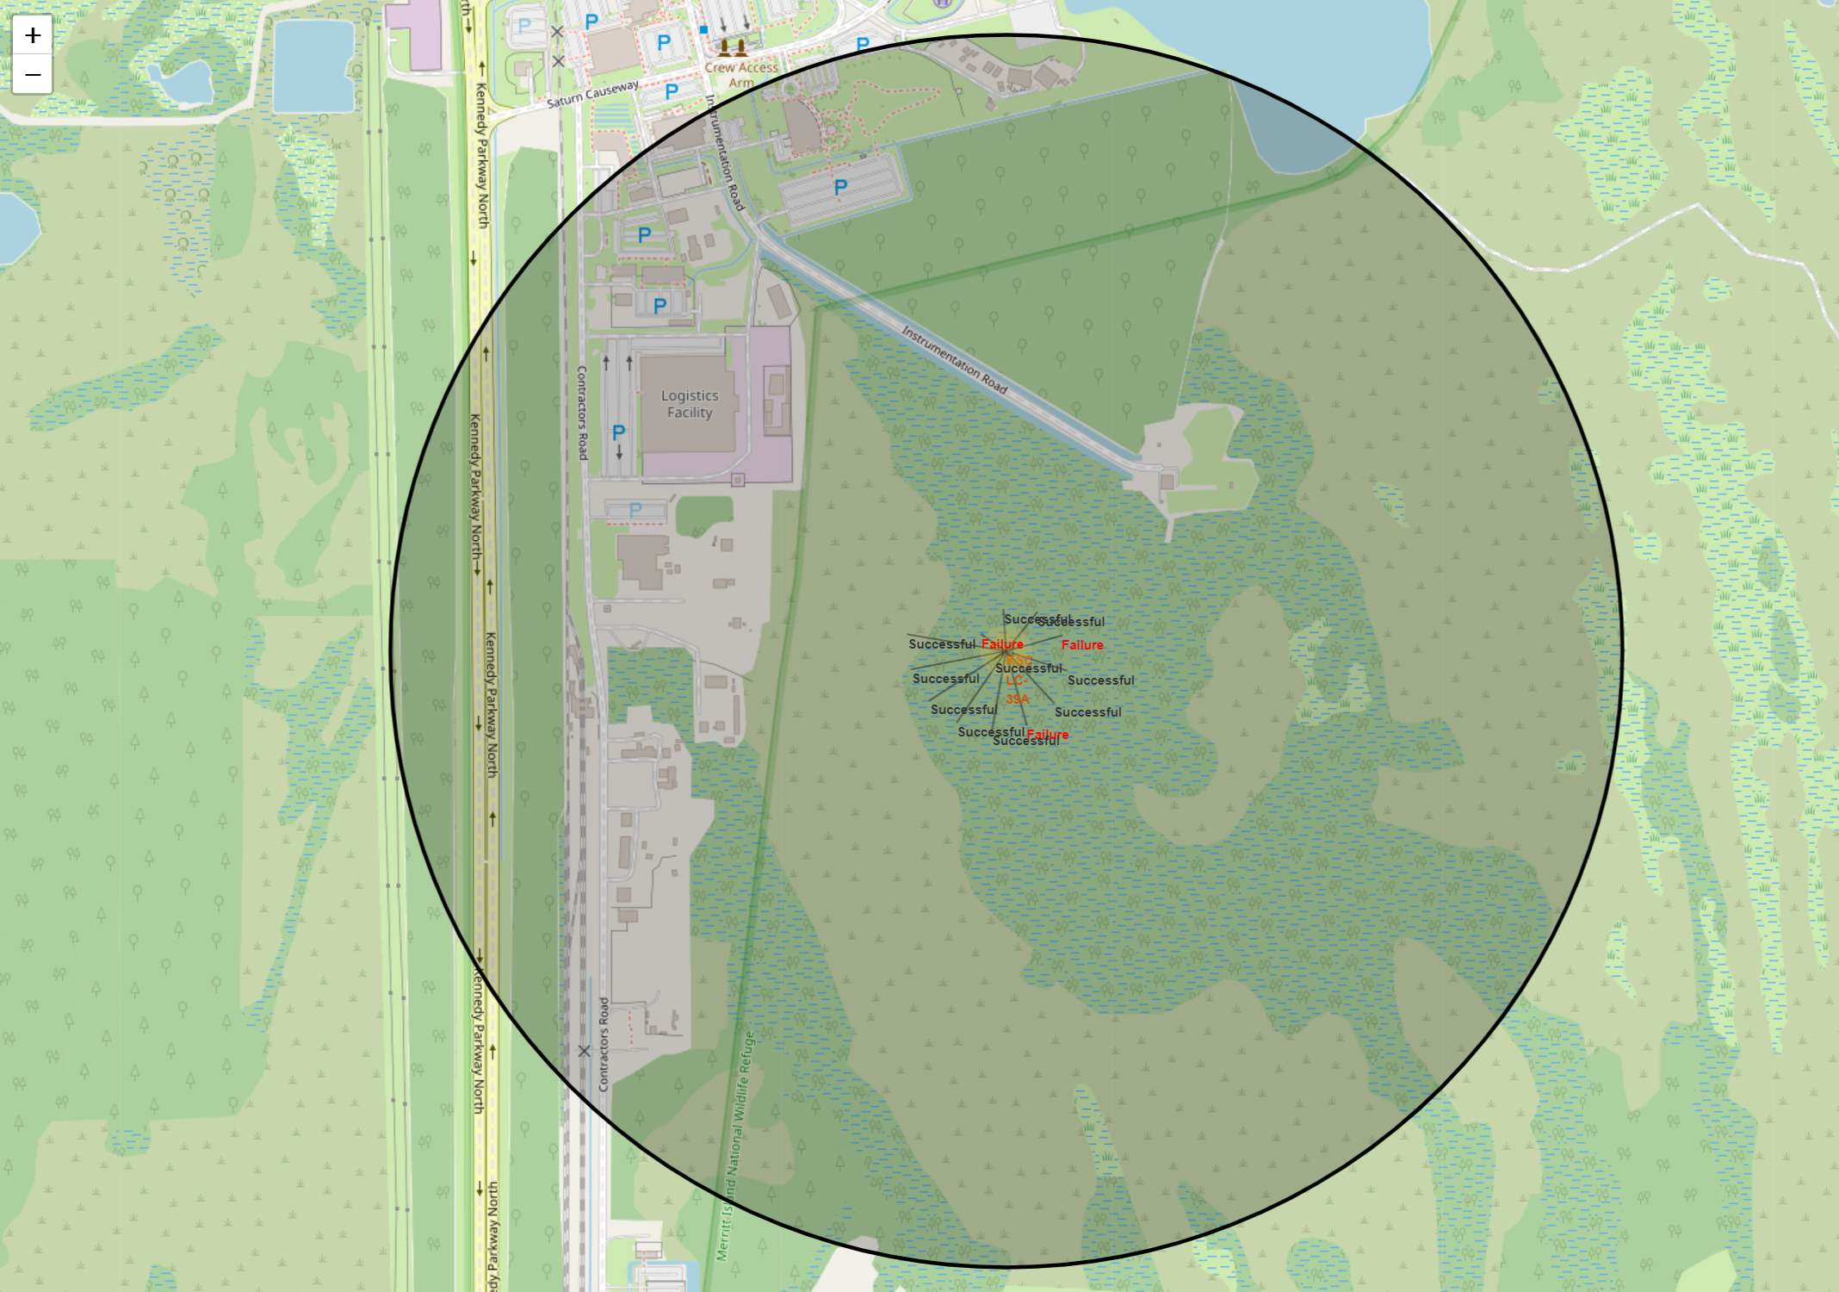
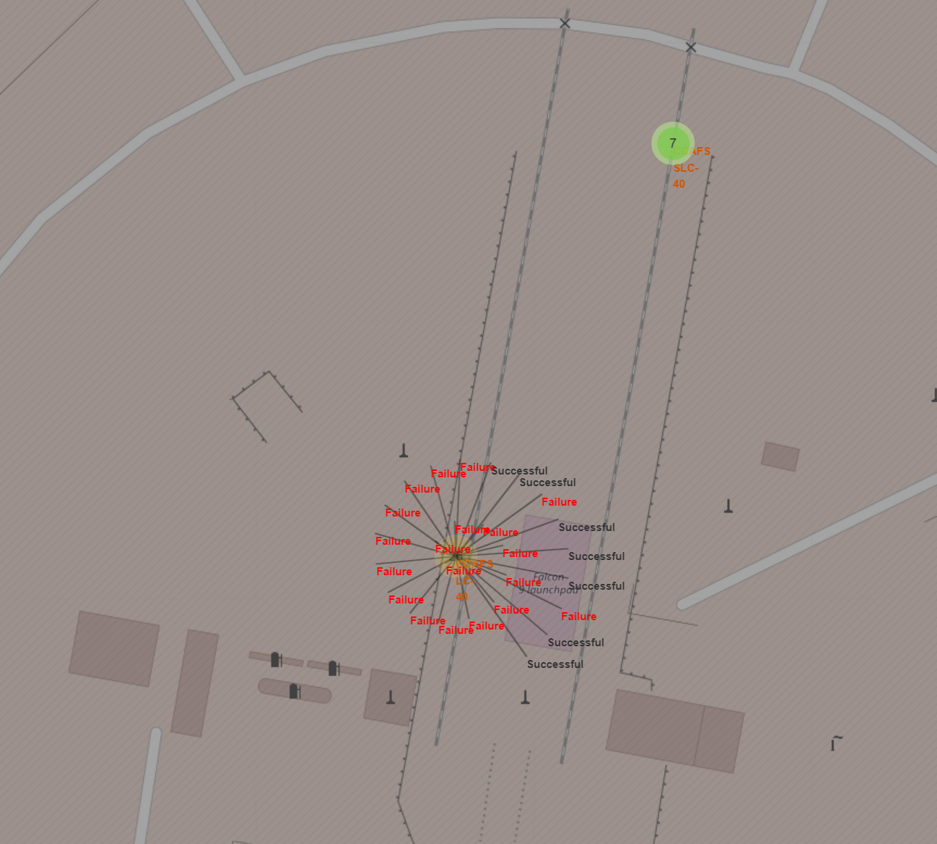
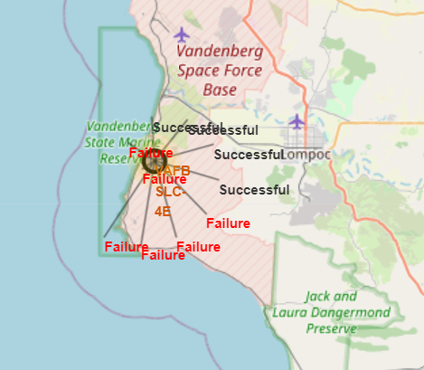
Missions completed at each Launch Site
Explore the folium map and make a proper screenshot to show the color-labeled launch outcomes on the map

Slide 39
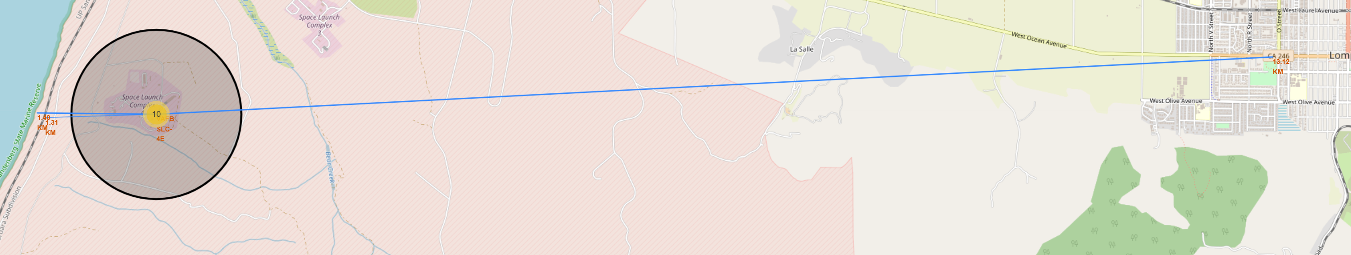
Proximities to the VAFB SLC-4E Site
There is a coastline, and railway around 1.3 km from the site and the town of Lompoc about 13.12km away.

Slide 40

Section 4

Slide 41
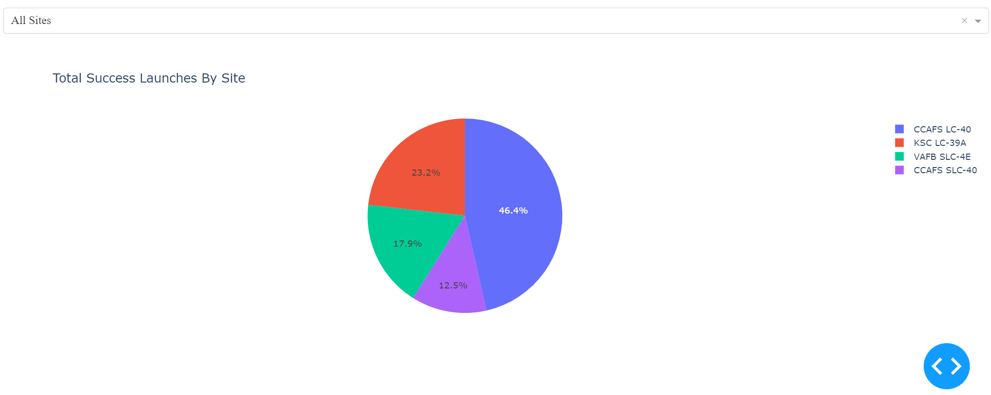
Success Rates of All Launch Sites
CCAFS LC-40 had the highest success rate followed by KSC LC-39A

Slide 42
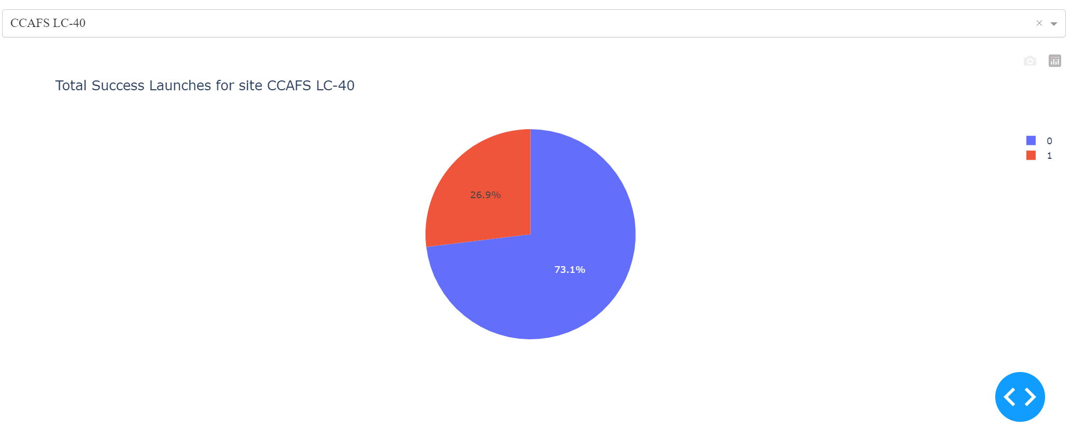
Success Count of CCAFS LC-40
73.1% of all the launches from the CCAFS LC-40 Launch Site were a success.

Slide 43
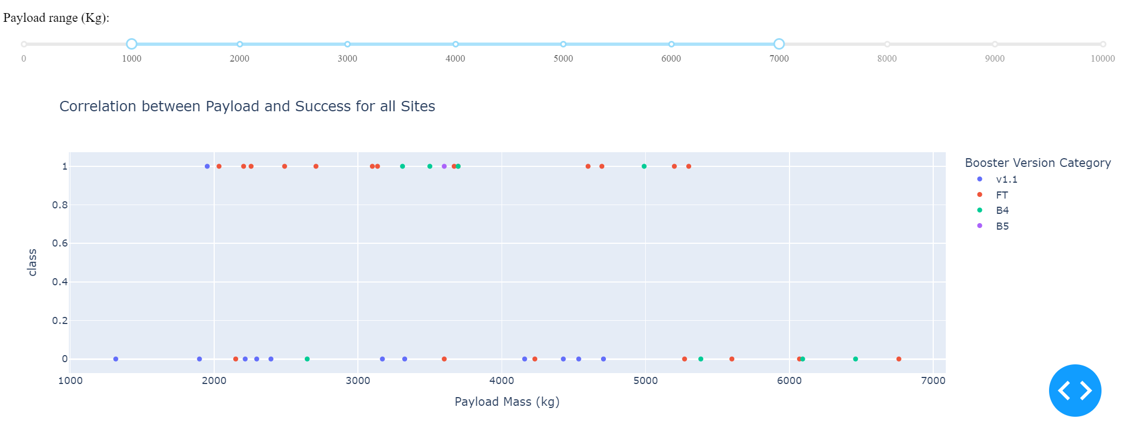
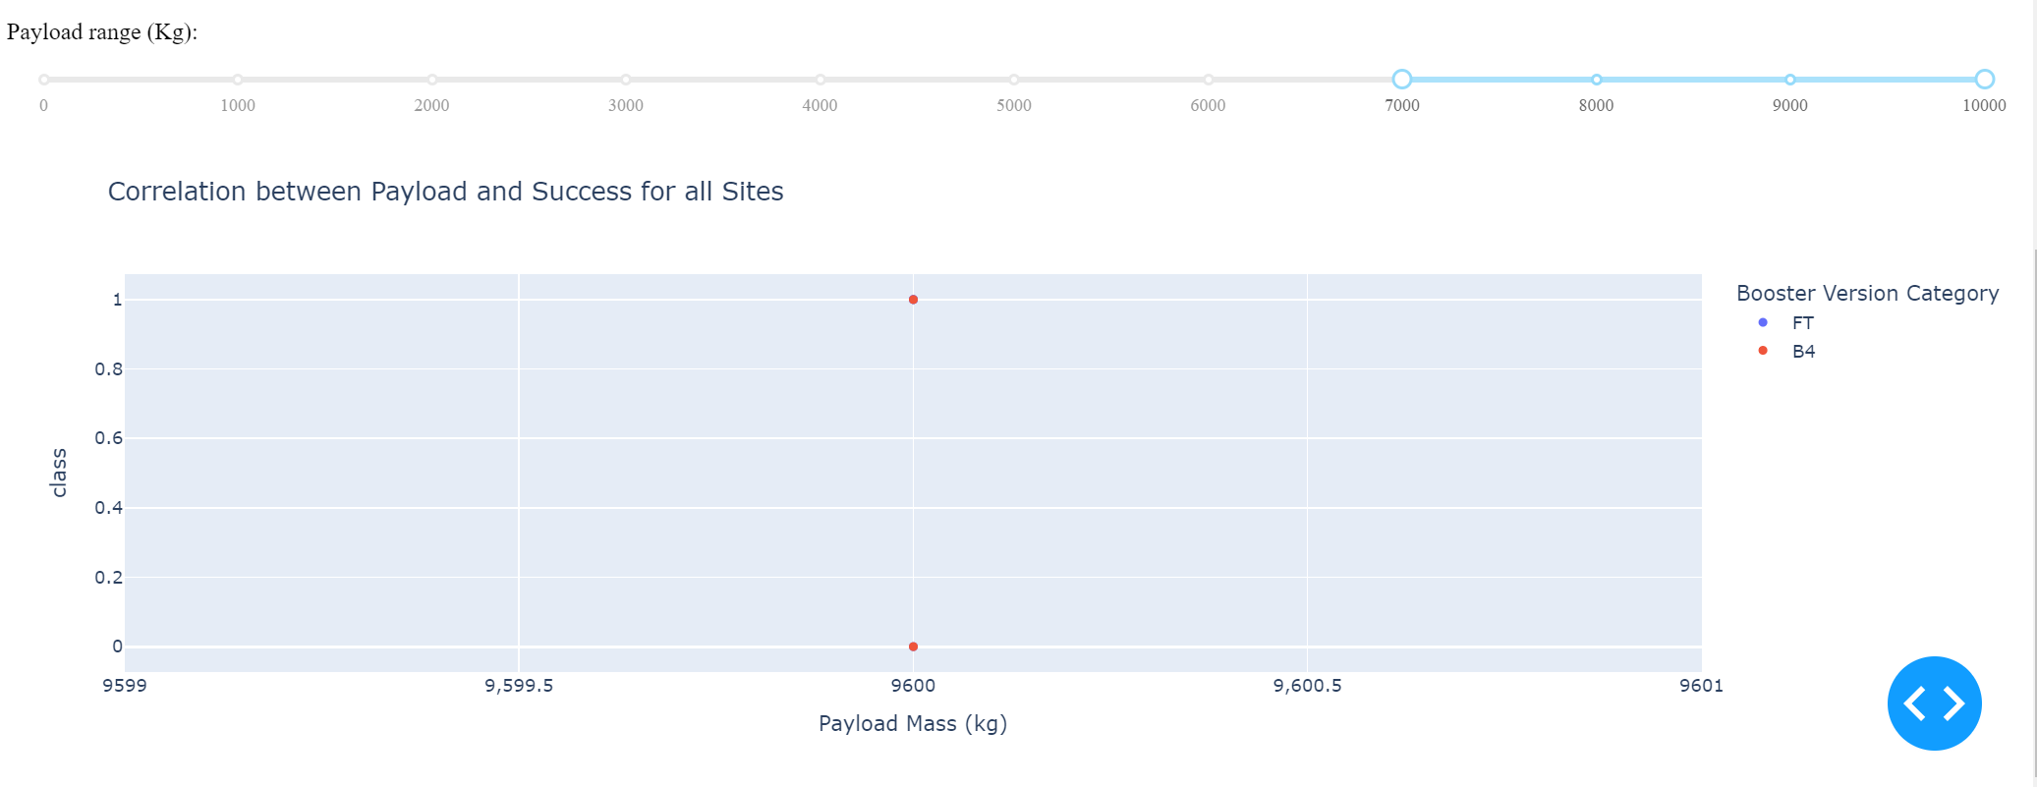
Payload Mass vs Launch Outcomes
Most successful launches had a booster with payload mass between 1000kg and 7000kg.

Slide 44

Section 5

Slide 45
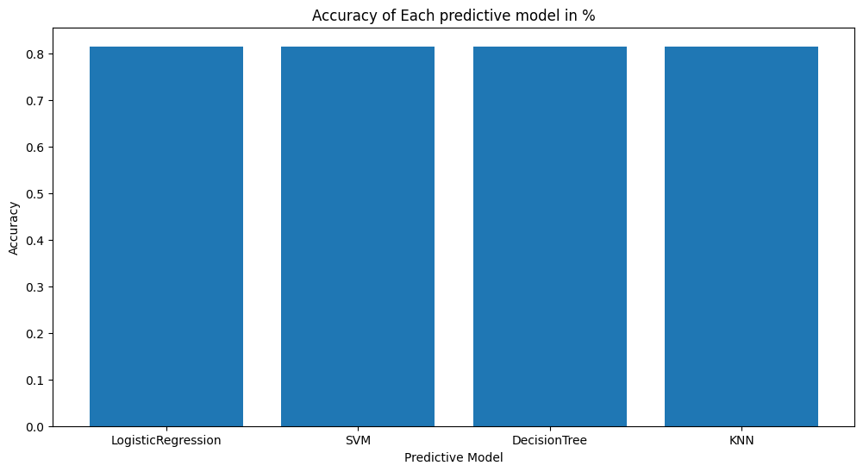
Classification Accuracy
As seen below, all predictive models have the same accuracy rate based on their F1_scores (81.48) and .score() accuracy values(83.33).

Slide 46

Confusion Matrix of the Best Performing Model
The Confusion Matrix of the Logistic Regression Model is shown below:
3 True Negatives, 3 False Positives, 0 True Negatives, 12 True Positives, from a total of 18 samples.

Slide 47
Conclusions
Most Successful Falcon9 launches originate from the CCAFS LC-40 Launch Site.
Most Successful Falcon9 launches have a payload mass between 1000kg and 7000kg
Almost all Launch Sites are by the coastline and have either a city/town or a railroad next to them.
All 4 predictive models used proved to be equally efficient in predicting the success of future Falcon9 Missions
Thus, we can with a significant amount of confidence, predict the success of future Falcon9 missions, given that we are provided with relevant launch data such payload mass, launch site,

Slide 48
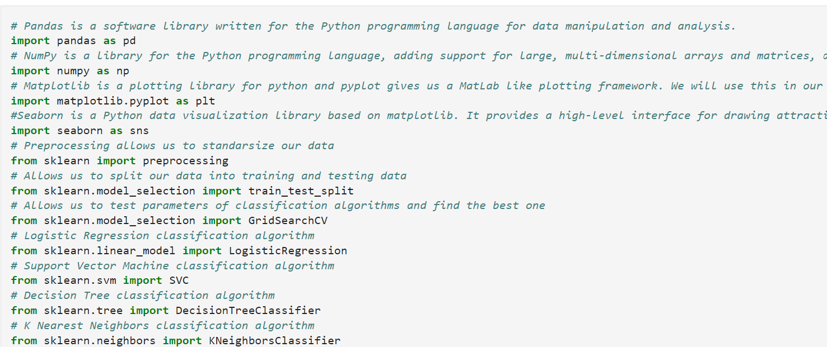
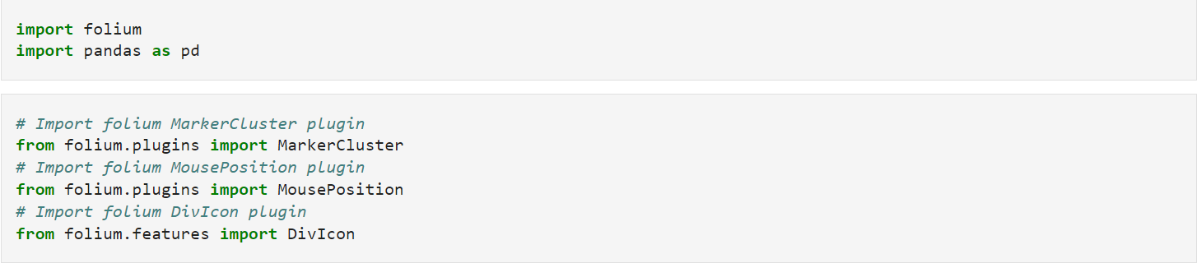
Appendix
Most of the python notebooks included in the links have the following imports:

Slide 49


